Slide 1
Stay-At-Home Pathway
McLean County Area EMS System
2020

Slide 2
Purpose
The purpose of this policy is to reduce transports during pandemic level events
This policy is only enacted by the EMS system when deemed necessary
This only applies to pandemic related calls
(i.e this would NOT apply to cardiac events, psych evals, abdominal pain, ect.)

Slide 3
Application
When the EMS System enacts Plan P of the System Pandemic Plan
Only can be used by BLS or higher providers/units. NOT for EMR
Refusals will be QA for appropriate use
May only be used for pandemic related calls

Slide 4
Policy
If you are dispatched for a person with pandemic related symptoms, and the patient meets low acuity, you may suggest the patient stay at home
Patient must meet low acuity criteria
Patient must be agreeable to staying at home

Slide 5
Low Acuity Definition
Patient must meet the following criteria:
Patients must meet the following criteria:
The patient is >18 and <60 years of age
The patient has no significant comorbidities which may include but are not limited to:
Diabetes
Heart disease
Chronic lung disease (COPD, Asthma, ect.)
Chronic renal disease (or dialysis)
Liver disease
Cancer
Autoimmune disorders
Chemotherapy patients
Patients on immunosuppressant medication
Pregnant women
Vitals
Respiratory rate >8 and <20
Heart Rate less than <110
Systolic BP >90mmHg and <160mmHg
O₂ saturation >95% on room air or within normal limits if they are on home O₂
GCS 15
Temp <102°f
Absence of respiratory distress, syncope, cyanosis, diaphoresis and chest pain (except for minor chest pain upon coughing)
Patient is alert and oriented and has medical decision-making capacity
Patient has a working telephone
Patient is capable of caring for themselves

Slide 6
If Patient Meets Low Acuity Criteria
If patient meets criteria the following statement should be read:
“Due to the recent outbreak of coronavirus, hospitals are seeing increased number of patients. Due to your symptoms being minor currently and your vitals falling within normal rangers, we highly recommend that you stay at home and self-quarantine. This protects you from additional potential exposures. We also recommend that you speak with your primary care physician or contact either the Carle or OSF hotlines to help guide you to find a physician to be seen by. If your symptoms worsen, you may call 911. Are you agreeable to this?”

Slide 7
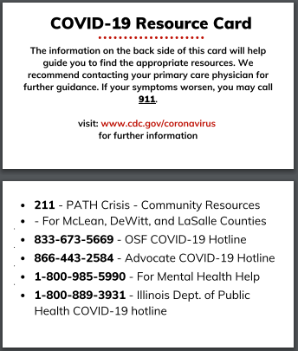
If Patient Meets Low Acuity Criteria
Front
If patient agrees to criteria
Fill out refusal and have them sign it
Leave them a COVID-19 resource card
Recommend the following for them
Drink plenty of fluids
Take over-the-counter medications as directed
Take temperature regularly
Encourage patient to have someone check in on them
Follow up with Primary Care physician
If symptoms worsen, call 911
Back

Slide 8
Refusal Documentation
Document using system refusal
In your chart, make sure you document
Patients Vitals
Medical History
Physical Assessment
Document thoroughly
Must record that patient meets all criteria (ie, take picture of criteria worksheet, fill out ePCR work sheet)

Slide 9
If Patient Does Not Meet Criteria
If a patient does not meet criteria and does not want to go to the hospital, call medical control to preform a high-risk refusal

Slide 10
Patient Meets Criteria, but Does Not Want to Stay Home
If patient meets criteria, but is insistent on being transported, we will transport the patient.
Do not argue with patients

Slide 11
When in doubt
If you have concerns leaving a patient at home, it is better to err on the side of caution and transport the patient.
Our goal is patient safety and their wellbeing

Slide 12
Reporting
We ask all agencies to keep a log (run numbers) of when this was used
This will be turned in at the end of use of Plan P
It may be requested to share log periodically with the QA Coordinator through out the pandemic

Slide 13
Agency Requirements
Document ALL providers are trained on application of this process
Record ALL uses of the Stay At Home Pathway
Report all issues that arise during use of this policy via IOR
Failure to follow policy appropriately will result in removal of use or individual corrective action

Slide 14
FAQs
Can we use this on any patient?
No just patients with pandemic related symptoms
When can we start using this?
This will only be used with the EMS System goes to Plan P of our pandemic plan. You can not use this until Plan P is implemented
What do I need to document
You will document just like you do for any refusal.
How do we get the COVID Resource Cards?
The EMS office has ordered these cards and will distribute them as soon as they arrive

